Slide 1
Efficient dual numbers reverse automatic differentiation by well-known program transformations
Paper by Tom Smeding and Matthijs Vákár
Presentation by Simon van Hus

Slide 2
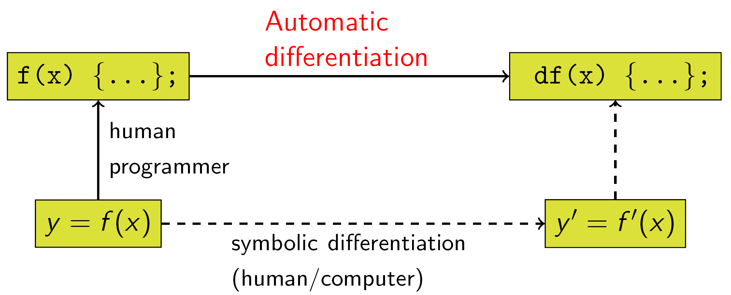
Automatic Differentiation
Manual Differentiation
Symbolic Differentiation
Numeric Differentiation
Automatic Differentiation

Slide 3
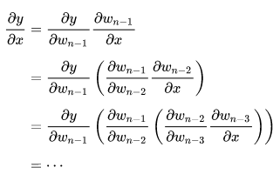
Automatic Differentiation
Manual Differentiation
Symbolic Differentiation
Numeric Differentiation
Automatic Differentiation
Forward Mode

Slide 4
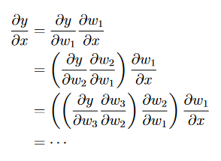
Automatic Differentiation
Manual Differentiation
Symbolic Differentiation
Numeric Differentiation
Automatic Differentiation
Forward Mode
Reverse Mode

Slide 5
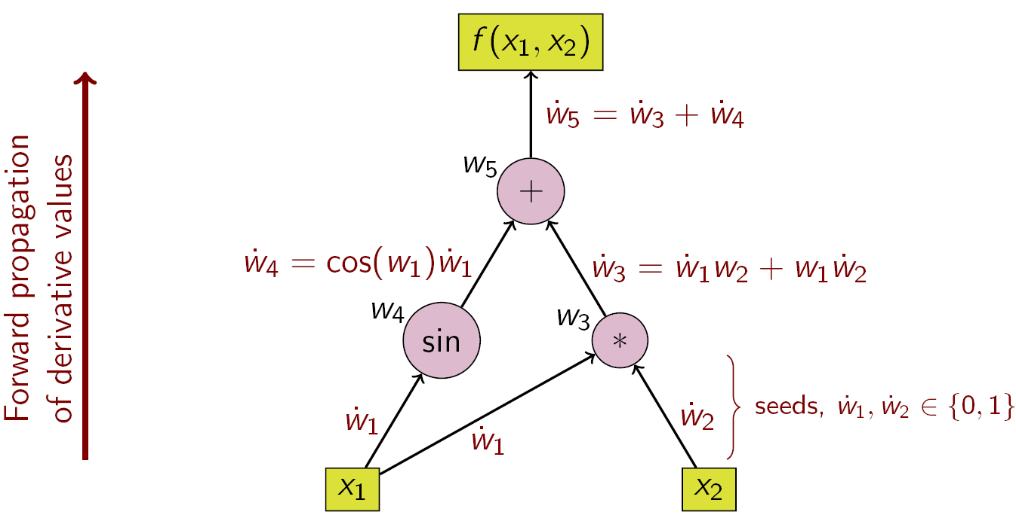
Dual Numbers
Forward Mode
Derivatives

Slide 6
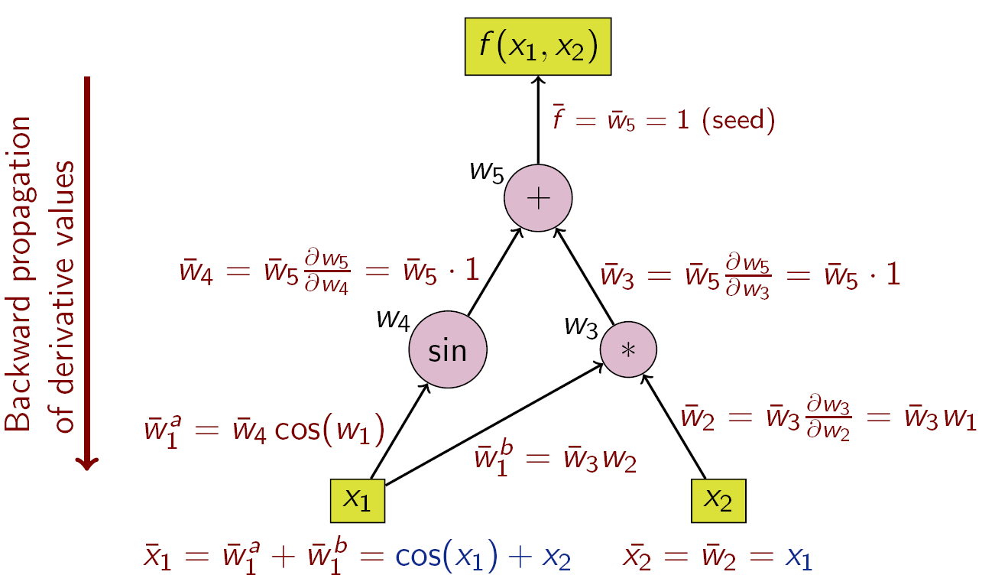
Dual Numbers
Forward Mode
Derivatives
Reverse Mode
Adjoints

Slide 7
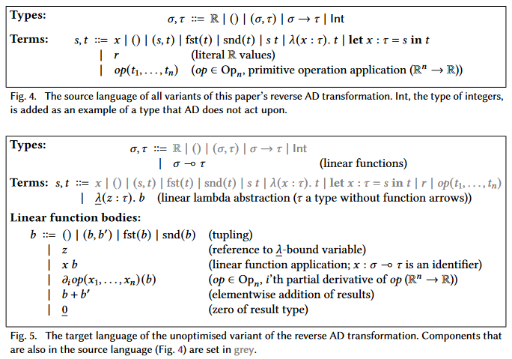
Naïve Reverse AD
Source and Target Languages

Slide 8
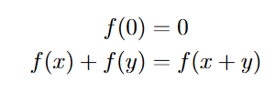
Naïve Reverse AD
Source and Target Languages
Linear Functions

Slide 9
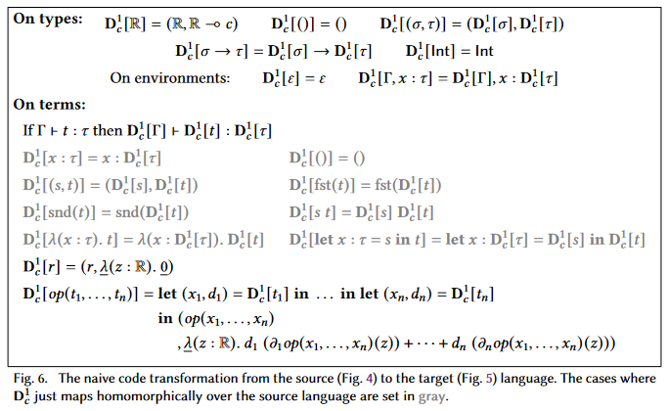
Naïve Reverse AD
Source and Target Languages
Linear Functions
Source Code Transformation

Slide 10
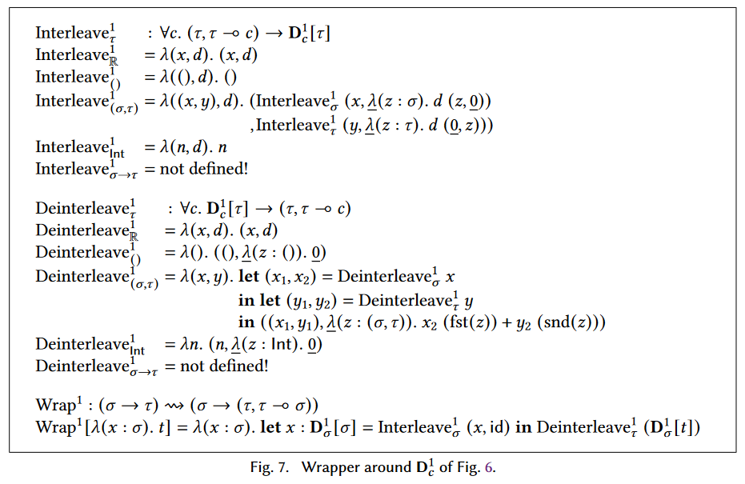
Naïve Reverse AD
Source and Target Languages
Linear Functions
Source Code Transformation
API Wrapper

Slide 11
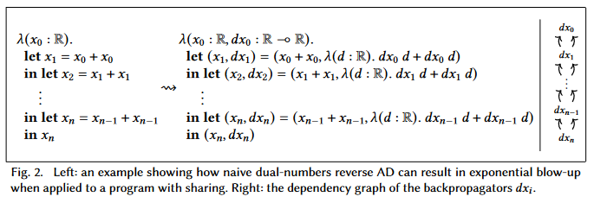
Linear Factoring
Duplicate backpropagator calls

Slide 12
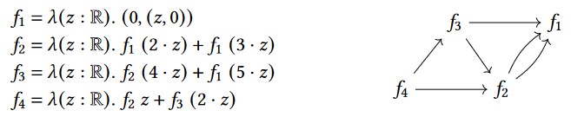
Linear Factoring
Duplicate backpropagator calls

Slide 13
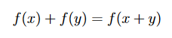
Linear Factoring
Duplicate backpropagator calls
Linear Factoring

Slide 14
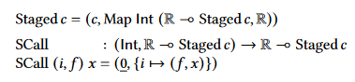
Linear Factoring
Duplicate backpropagator calls
Linear Factoring
Execution Order

Slide 15
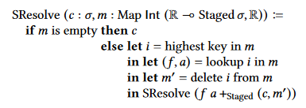
Linear Factoring
Duplicate backpropagator calls
Linear Factoring
Execution Order
Resolving “Staged c”

Slide 16
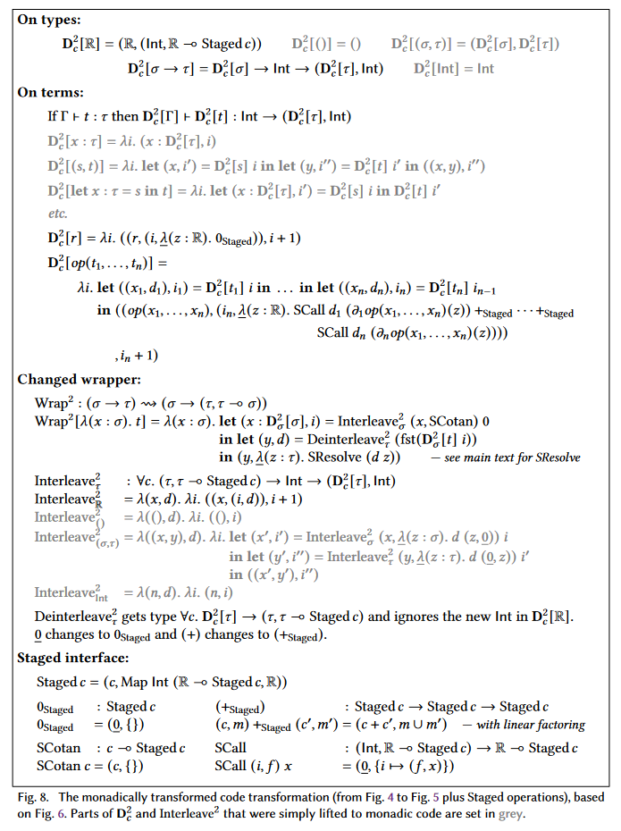
Linear Factoring
Duplicate backpropagator calls
Linear Factoring
Execution Order
Resolving “Staged c”
New Transformation

Slide 17
Linear Factoring
Duplicate backpropagator calls
Linear Factoring
Execution Order
Resolving “Staged c”
New Transformation

Slide 18
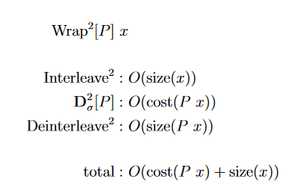
Current Complexity
Primal Pass

Slide 19
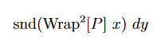
Current Complexity
Primal Pass
Reverse Pass

Slide 20
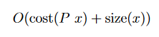
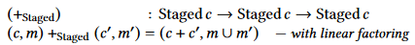
Current Complexity
Primal Pass
Reverse Pass
Expensive Monoid Operations

Slide 21
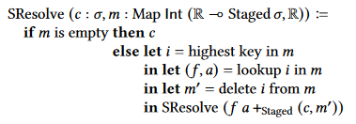
Current Complexity
Primal Pass
Reverse Pass
Expensive Monoid Operations
Map operations in SResolve

Slide 22
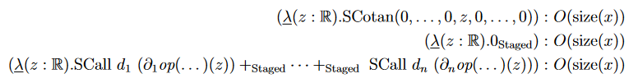
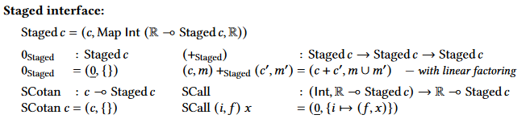
Current Complexity
Primal Pass
Reverse Pass
Expensive Monoid Operations
Map operations in SResolve
SCall in backpropagators

Slide 23
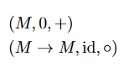
Cayley Transformation
Monoid Isomorphism

Slide 24
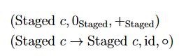
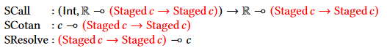
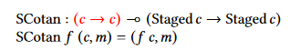
Cayley Transformation
Monoid Isomorphism
Transforming Staged c

Slide 25
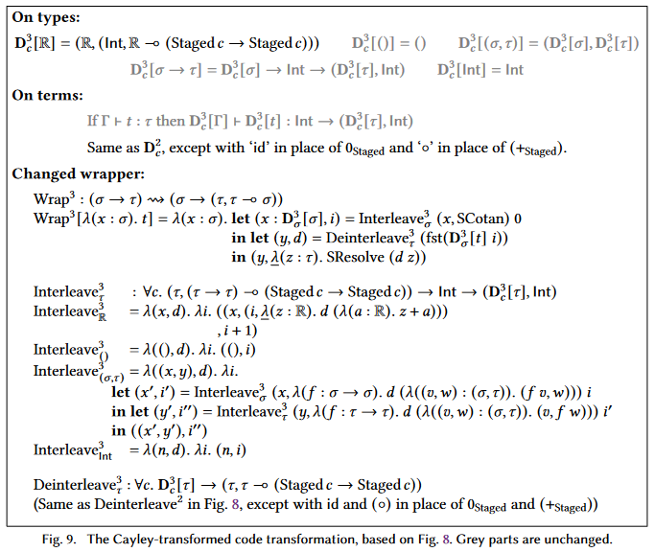
Cayley Transformation
Monoid Isomorphism
Transforming Staged c
New transformation

Slide 26
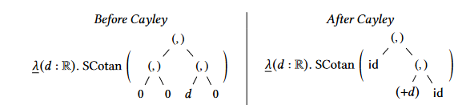
Cayley Transformation
Monoid Isomorphism
Transforming Staged c
New transformation
Remaining Problem

Slide 27
Efficient Gradient Updates
Only collect scalars

Slide 28
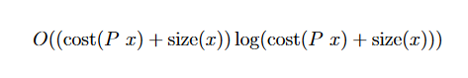
Efficient Gradient Updates
Only collect scalars
Remaining problems:
Expensive Monoid Operations
Map Operations in SResolve
SCall in backpropagators

Slide 29
Efficient Gradient Updates
Only collect scalars
Remaining problems:
Expensive Monoid Operations
Map Operations in SResolve
SCall in backpropagators

Slide 30
Mutable Arrays
Map operations in SResolve

Slide 31
Mutable Arrays
Map operations in SResolve
Maps to Arrays

Slide 32
More Optimizations
No cotangent collection array

Slide 33
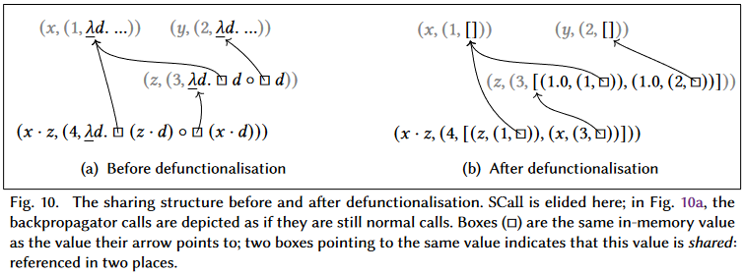
More Optimizations
No cotangent collection array
Defunctionalization of backpropagators

Slide 34
More Optimizations
No cotangent collection array
Defunctionalization of backpropagators
Taping

Slide 35
Summary
Dual-Numbers Reverse AD
Linear Factoring
Cayley Transformation
Efficient Gradient Updates
Mutable Arrays
Even more optimizations

Slide 36
Summary
Dual-Numbers Reverse AD
Linear Factoring
Cayley Transformation
Efficient Gradient Updates
Mutable Arrays
Even more optimizations
Extensions to the source language
Implementation and Performance

Slide 37
Questions?
Presentation by Simon van Hus

